Slide 1
Example of figures and tables we would like to get from Ellen for bird data
Using VICK as an example

Slide 2
As a starting point, select the top 20 bird species (or fewer, if Ellen recommends this) at VICK. The basis for selection could be those species with the highest average number of observations per year or some similar criteria
Considerations (which may influence the basis of selection):
From 2009 to 2017, there was a panel design among 60 points, with only a subset of points sampled in each year
In 2018, just 32 of the 60 points were selected as the final set of long-term points, and the panel design was eliminated, so these 32 points were sampled each year from 2018 onward
From 2018 onward, each of the 32 points was sampled twice per season

Slide 3
Using all available points and all years (though other approaches may be better), the top 20 breeding landbirds are
ScientificName | CommonName | Grand Total | mean per year
Cardinalis cardinalis | northern cardinal | 2478 | 177
Melanerpes carolinus | red-bellied woodpecker | 1295 | 93
Thryothorus ludovicianus | Carolina wren | 877 | 63
Molothrus ater | brown-headed cowbird | 852 | 61
Cyanocitta cristata | blue jay | 755 | 54
Coccyzus americanus | yellow-billed cuckoo | 723 | 52
Parus bicolor | tufted titmouse | 723 | 52
Vireo griseus | white-eyed vireo | 619 | 44
Piranga rubra | summer tanager | 557 | 40
Empidonax virescens | Acadian flycatcher | 536 | 38
Passerina cyanea | indigo bunting | 535 | 38
Hylocichla mustelina | wood thrush | 491 | 35
Poecile carolinensis | Carolina chickadee | 473 | 34
Vireo olivaceus | red-eyed vireo | 394 | 28
Wilsonia citrina | hooded warbler | 382 | 27
Polioptila caerulea | blue-gray gnatcatcher | 375 | 27
Mimus polyglottos | northern mockingbird | 254 | 18
Zenaida macroura | mourning dove | 251 | 18
Corvus brachyrhynchos | American crow | 250 | 18
Icterus spurius | orchard oriole | 217 | 16

Slide 4
After making this initial cut, it may be of interest to go back and check for additional species that may have once been high but are now low, or vice versa. With these 20+ species, fit both the N-mixture and GLMM models, using all data, including both visits per year when available
Information we probably want to present based on these analyses:
For both the GLMM model and the n-mixture model:
For each species, estimates of index of abundance per year. This would be good to have displayed visually, as well as a table with of estimates for each year with 95% CI. See example FIGURE 1 on next slide
For each species, list of which co-variates were important, and their sign and magnitude (table). Also provide here other details about the model fit and underlying distributions used
For all species that were analyzed at VICK, a single figure showing whether each species had a significant slope in index of abundance, including its size and direction. See example FIGURE 2 on slide after next.
We will probably mostly just present the GLMM results, but we may want to include some actual abundance estimates from the n-mixture model, following Matt Marshall’s approach.

Slide 5
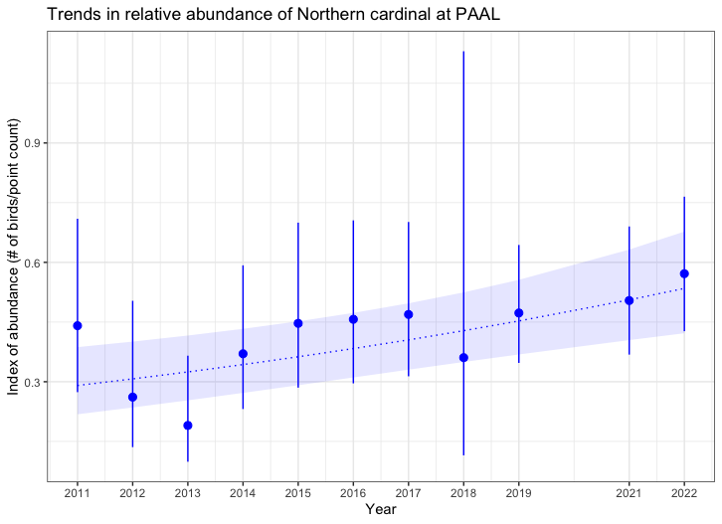
Example FIGURE 1
From slide 12 of 2023 STAC
presentation by ellen

Slide 6
Example FIGURE 2
From slide 15 of 2023 STAC presentation by ellen, modified to make the point.
This shows only 8 birds, but maybe there could be up to 20? I have no idea what’s a realistic expectation, so let’s just find out

Slide 7
Example FIGURE 2,
alternate
From Forest Data Visualization examples—
Similar approach but showing the species on
The y rather than x axis.

